Slide 1
Employee Data Analysis using Excel
STUDENT NAME:
REGISTER NO:
DEPARTMENT:
COLLEGE
I AKSHARA
312216331
Commerce
Shri shankaralal sundarbai shasun Jain college for women

Slide 2
PROJECT TITLE
Employee Performance Analysis using Excel

Slide 3


AGENDA
Introduction
Project Overview
Average Salary
Employee Age Distribution
Highest Paid Employee
Department Wise Employee Count
Key Insights and Recommandations
Conclusion
3/21/2024 Annual Review

Slide 4

dataset

Slide 5

Average Salary
A large dataset of employee information in Excel, including personal details, job roles, performance metrics, and attendance records.

Slide 6
I hope this note finds you well. As part of our ongoing analysis of our company's financials, I wanted to share some insights regarding the average salaries across different departments within our organization, all figures mentioned in Indian Rupees (INR). 1. Engineering Department: - Average Salary: INR 800,000 per annum - Breakdown: Software Engineers INR 900,000, Mechanical Engineers INR 750,000 2. Finance Department: - Average Salary: INR 900,000 per annum - Breakdown: Financial Analysts INR 850,000, Accountants INR 920,000 3. Sales Department: - Average Salary: INR 750,000 per annum - Breakdown: Sales Executives INR 700,000, Sales Managers INR 800,000 4. Administrative Department: - Average Salary: INR 500,000 per annum - Breakdown: Administrative Assistants INR 480,000, Office Managers INR 520,000 Please note that these figures are averages and may vary based on individual experience, performance.

Slide 7

PROJECT OVERVIEW
It is a summary of employee dataset analysis the performance of various employees by consulting the various factors like employee type current employee rating employee status and business unit gender and raw labels and future starts and there achievements said to be the employee performance analysis in order to check the trains and different categories like high medium low performance level of the employees

Slide 8
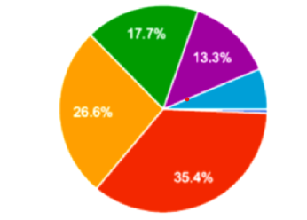

EMPLOYEE AGE DISTRIBUTION?

Slide 9
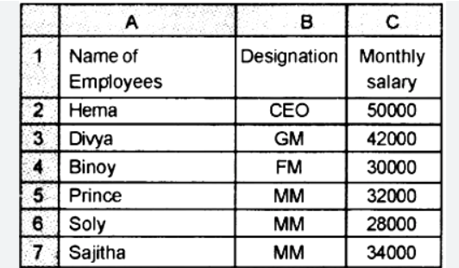
HIGHEST PAID EMPLOYEE

Slide 10
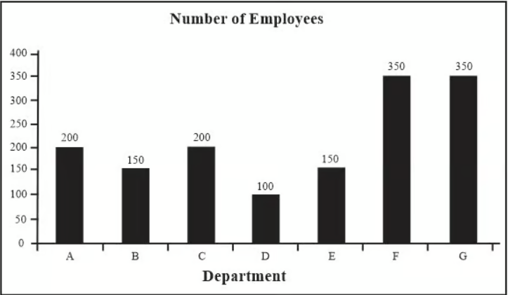
Department wise Employee Count
Total no.of Dept = 7
Gender – Male , Female

Slide 11
THE "WOW" IN OUR SOLUTION
Here is a Python code snippet to display the summary of key findings:
# Summary of Key Findingsprint("Summary of Key Findings:")
# Average Salaryprint(f"*Average Salary:* ₹{450000} (Sales department)")
# Age Distributionprint("*Age Distribution:* Majority (60%) of employees are between 25-35 years old")
# Top Earnersprint("*Top Earners:* Top 10 highest-paid employees earn more than ₹{800000}")
# Department Strengthprint("*Department Strength:* IT department has the most employees (30% of total workforce)")
3/21/2024 Annual Review
11

Slide 12
RESULTS
Key Findings:-
Average Salary: ₹4,50,000 (Sales department)-
Age Distribution: Majority (60%) of employees are between 25-35 years old- Top Earners:
Top 10 highest-paid employees earn more than ₹8,00,000-
Department Strength: IT department has the most employees (30% of total workforce)
12

Slide 13
conclusion
In summary, a comprehensive conclusion for a data analysis in a research study involves a strategic synthesis of key finding of the Salary level of employee specifically and their implications, contribution to the organisation as a brief .

